Slide 1


Finelight Media
Data Analysis
Rohnjose Saji

Slide 2
State of the Data
The dataset contained many columns with missing values, making analysis difficult.
Inconsistent data was observed in some columns with capitalization and formatting differences.
Two columns with over 90% missing values, were removed from the dataset.
Some columns had significant number of missing values, which were labeled as "Other" or "Unknown," leading to potential confusion during data visualization.

Slide 3
Issues with the Data and Proposed Solutions
Missing Values
Inconsistent Data Formatting
Removal of Columns with High Missing Values
Data Cleaning
Improved Data Collection

Slide 4


AUDIENCE ANALYSIS

Slide 5
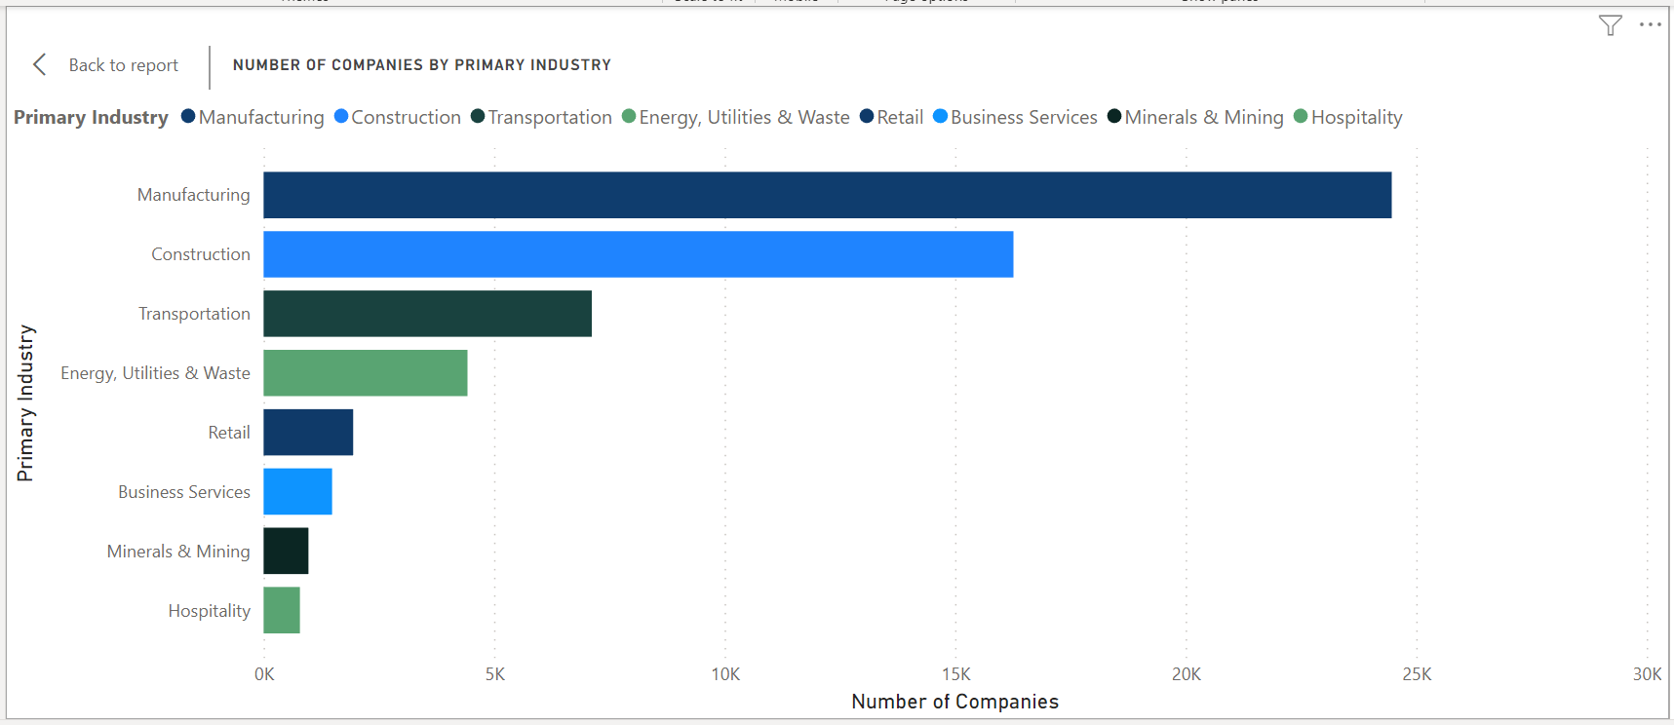
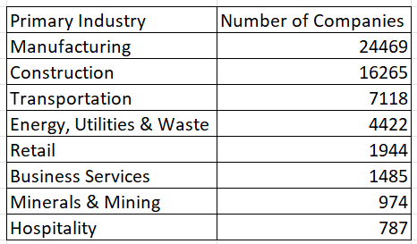
Primary Industries
Our audience consists of companies from various industries, with the majority being in manufacturing (40%), construction (26%), and transportation (11%).

Slide 6
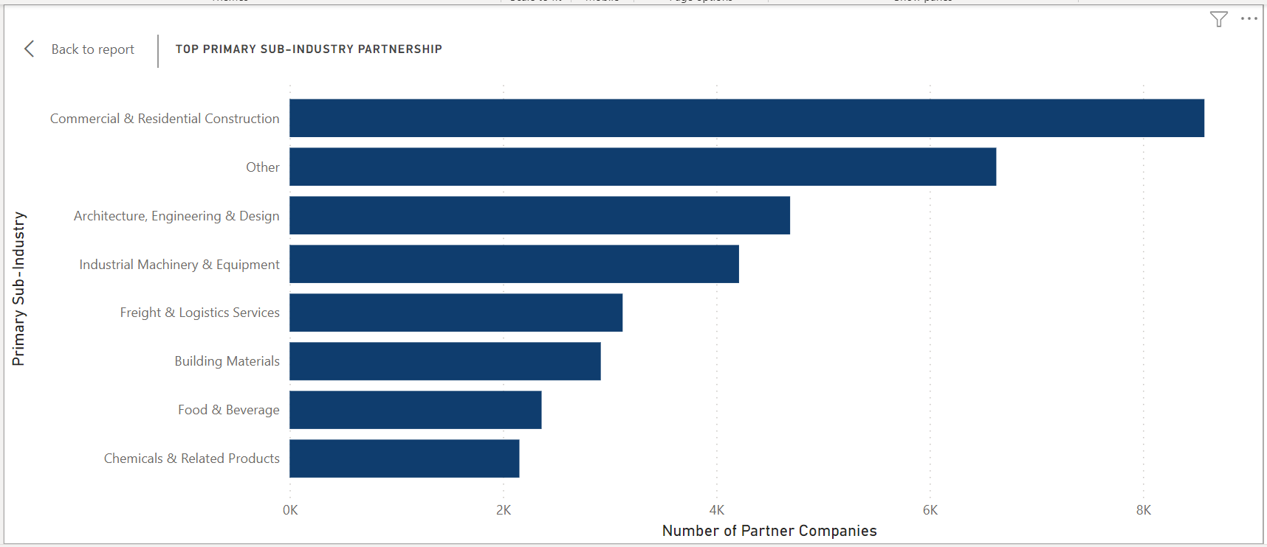
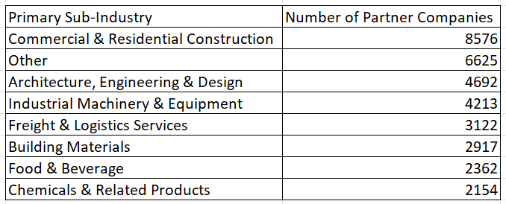
Primary Sub-Industries
The primary sub-industry of the companies that contact us are commercial and residential construction (14%), "Unknown" (10%), Architecture, engineering, and design (7%).

Slide 7
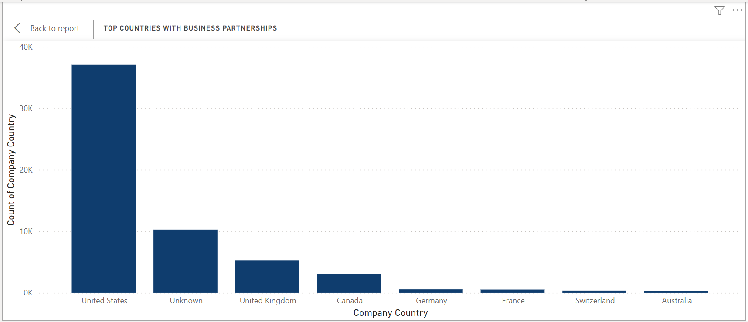
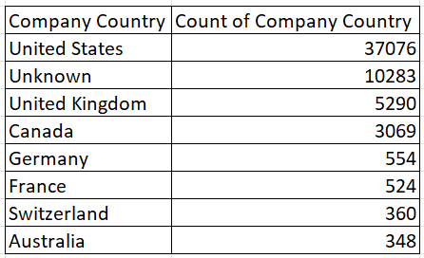
Countries with Business Partnership
Most of our clients are from the United States (60%), followed by the United Kingdom (8%). We have represented the missing values by "Unknown" (16%).

Slide 8
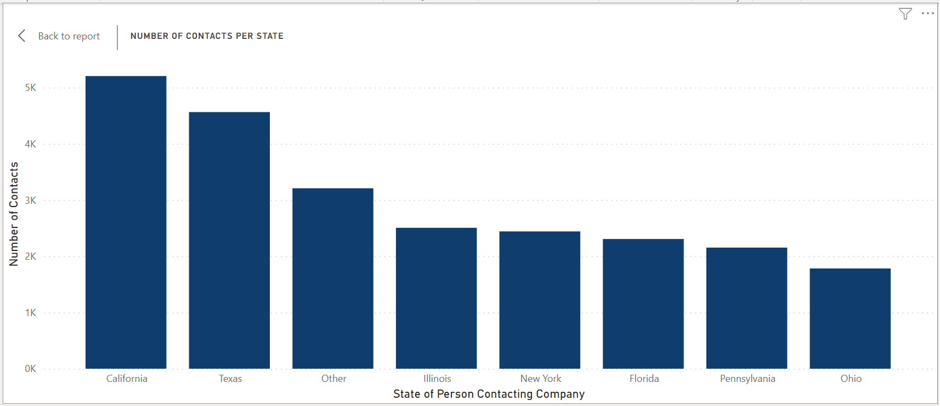
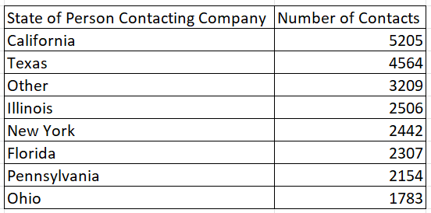
Number of Contact per State
The state with the most clients is California (8%), followed by Texas (7%), with the state for 5% of the contacts labeled as "Unknown".

Slide 9
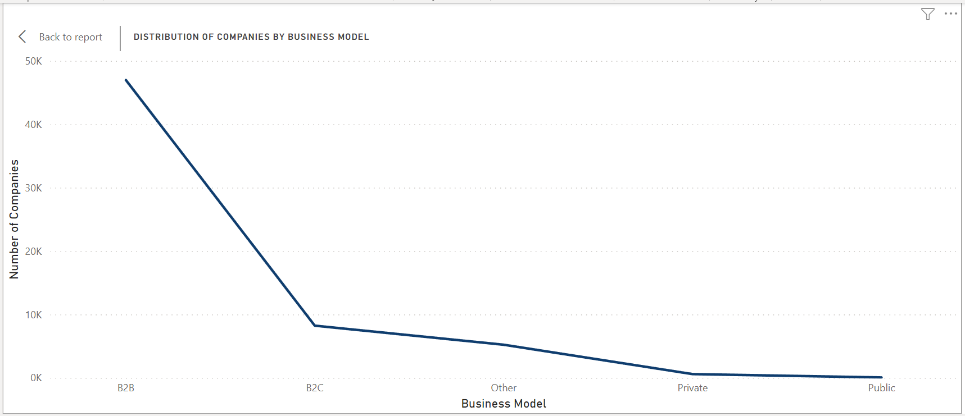
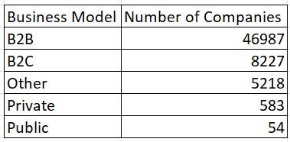
Business Model of Companies
The business model for most of our clients is B2B (76%), followed by B2C (13%), with 8% labeled as "Unknown".

Slide 10
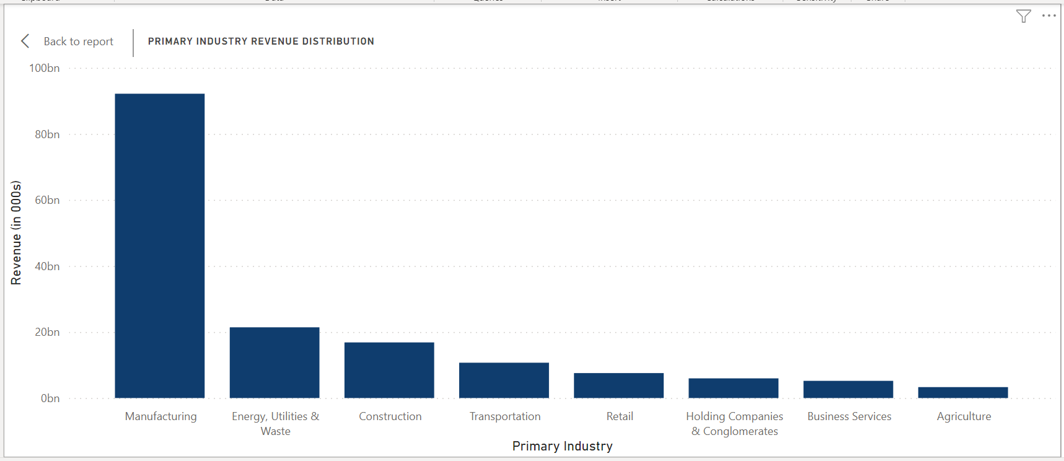
Revenue Distribution
Manufacturing companies make up the highest percentage of revenue for our company, followed by energy, utilities, and waste and then construction.

Slide 11
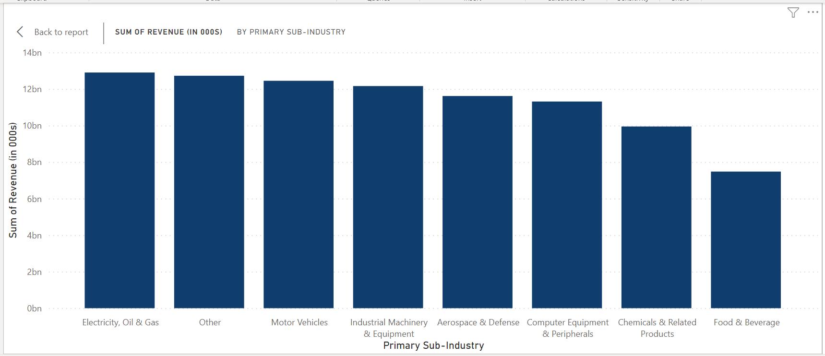
Electricity, Oil & Gas subindustry provides the highest revenue for the company

Slide 12
Analysis of Business Type and Best Marketing Prospects
Primary Industries: Manufacturing, construction, and transportation
Promising Sub-Industry: Commercial and residential construction
Client Locations: United States, United Kingdom
Revenue-Generating Industries: Manufacturing, Energy, utilities & waste and construction and Energy, Gas & Oil (Primary Sub Industry)
Best Prospects: B2B companies followed by B2C companies

Slide 13
Key Insights for Sales Team to Approach Businesses
Manufacturing, construction, and transportation are the top three primary industries of the companies that contact us. This suggests that our sales team should focus on targeting businesses in these industries as they are more likely to be interested in our products and services.
The United States is the country from which most of our business comes from. However, we also have a significant number of businesses with "unknown" location, which may indicate a potential market to explore. The United Kingdom is the third largest country in terms of business volume, so it may also be worth considering targeting businesses in this region.

Slide 14
Commercial and residential construction, architecture, engineering, and design are the top primary sub-industries of the companies that contact us. Our sales team should tailor their approach to these industries, highlighting the ways in which our products can help them meet their specific needs.
California & Texas are the top states from which our clients contact us. This suggests that our sales team should focus on these regions and tailor their approach accordingly.
B2B is the most common business model of the companies that contact us. This information should inform our sales team's approach and messaging, emphasizing the benefits of our products and services for B2B companies.

Slide 15
Manufacturing is the primary industry of the companies with which we have the highest revenue. Energy, utilities, and waste are the second highest, followed by construction. Our sales team should focus on targeting companies in these industries and emphasizing the ROI potential of our products.
It is also worth nothing that there are a significant number of "unknown" values in several of the columns. This may represent a potential market to explore, but it may also indicate incomplete or inaccurate data. Our sales team should exercise caution when targeting these businesses and conduct additional research to ensure they are a good fit for our products and services.

Slide 16
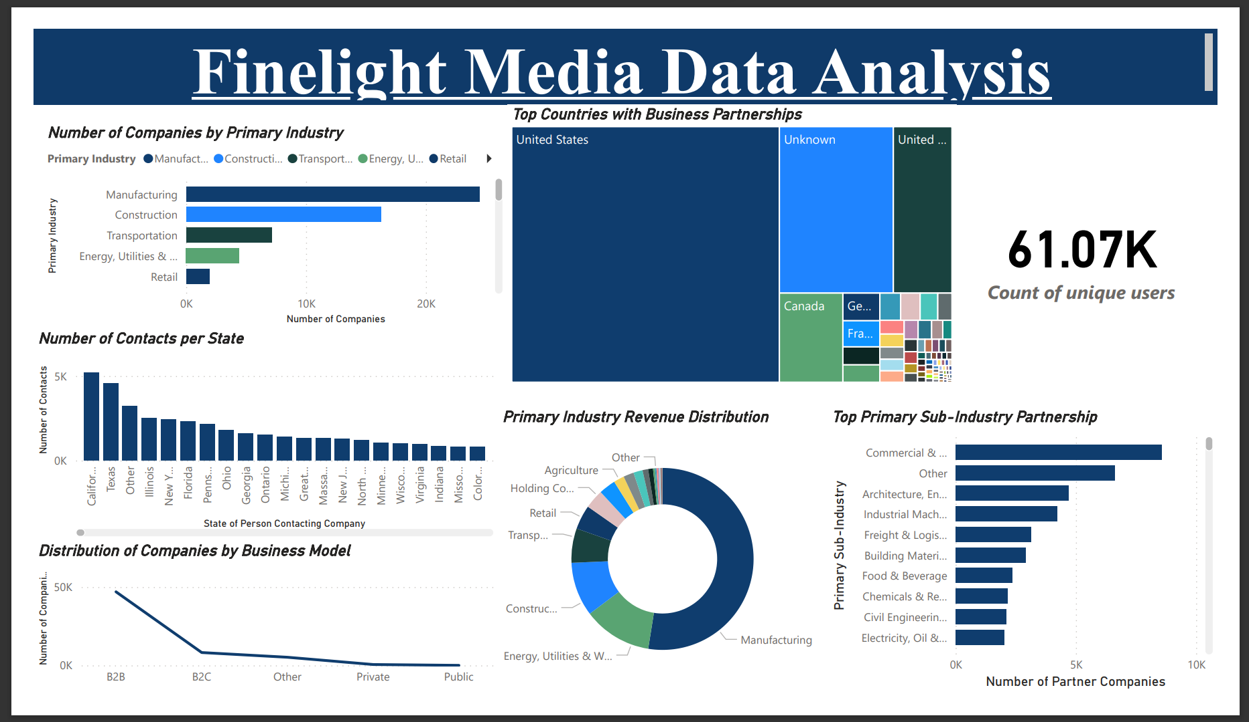

Slide 17
Thank You

